Slide 1
INDEXING
UNIT 4 : IMPLEMENTATION TECHNIQUES

Slide 2

Indexing
Indexing in DBMS is a technique that uses data structures to optimize the searching time of a database query.
It helps in faster query results and quick data retrieval from the database.
It also consumes lesser space in the main memory

Slide 3
Structure of indexing in database
Search key | Data reference
Primary key or candidate key
value

Slide 4




Search key
The first column is the Search key that contains a copy of the primary key or candidate key of the table.
These values are stored in sorted order so that the corresponding data can be accessed quickly.
Note: The data may or may not be stored in sorted order

Slide 5
Data Reference
The second column is the Data Reference or Pointer which contains a set of pointers holding the address of the disk block where that particular key value can be found.

Slide 6
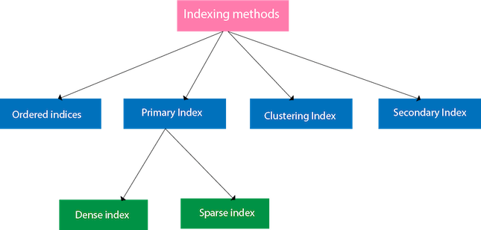

Slide 7
Ordered Indices
To make searching easier and faster, the indices are frequently arranged/sorted. Ordered indices are indices that have been sorted.

Slide 8
Primary index
Primary Index is an ordered file whose records are of fixed length with two fields.
The first field of the index replicates the primary key of the data file in an ordered manner,
The second field of the ordered file contains a pointer that points to the data-block where a record containing the key is available.

Slide 9

Dense index
In dense index, there is an index record for every search key value in the database.
This makes searching faster but requires more space to store index records itself.
Index records contain search key value and a pointer to the actual record on the disk.

Slide 10
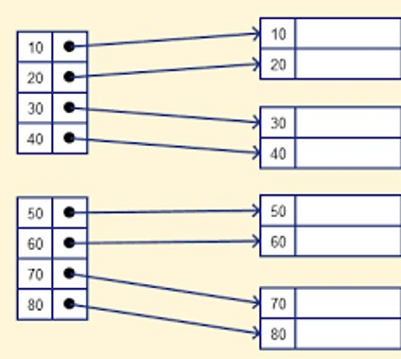

Slide 11
Sparse index
The index record appears only for a few items in the data file. Each item points to a block as shown.
To locate a record, we find the index record with the largest search key value less than or equal to the search key value we are looking for.
We start at that record pointed to by the index record, and proceed along with the pointers in the file (that is, sequentially) until we find the desired record.

Slide 12
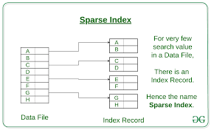

Slide 13
Clustered Indexing
Clustering index is defined on an ordered data file. The data file is ordered on a non-key field.
Sometimes the Index is created on non-primary key columns which might not be unique for each record.
In such a situation, you can group two or more columns to get the unique values and create an index which is called clustered Index.
This also helps you to identify the record faster

Slide 14
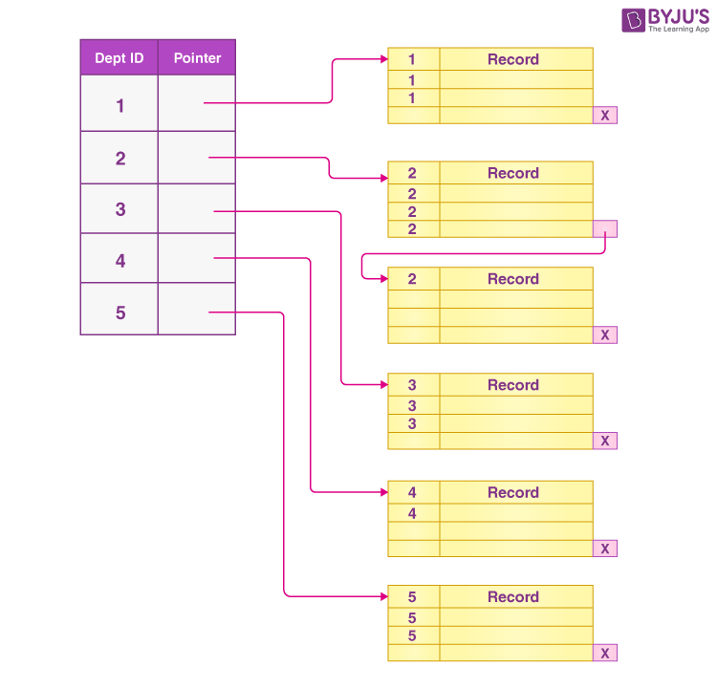

Slide 15
SECONDARY INDEX
The secondary Index in DBMS can be generated by a field which has a unique value for each record, and it should be a candidate key. It is also known as a non-clustering index.
This two-level database indexing technique is used to reduce the mapping size of the first level. For the first level, a large range of numbers is selected because of this; the mapping size always remains small.

Slide 16
